Slide 1
The Hustlers

Slide 2
Our Team
Isha Yadav (2110992064)
Himanshu Garg (2110992044)
Kavya Nagpal (2110992030)

Slide 3
Our Individual Projects
Calculator
Password Generator
Sudoku

Slide 4

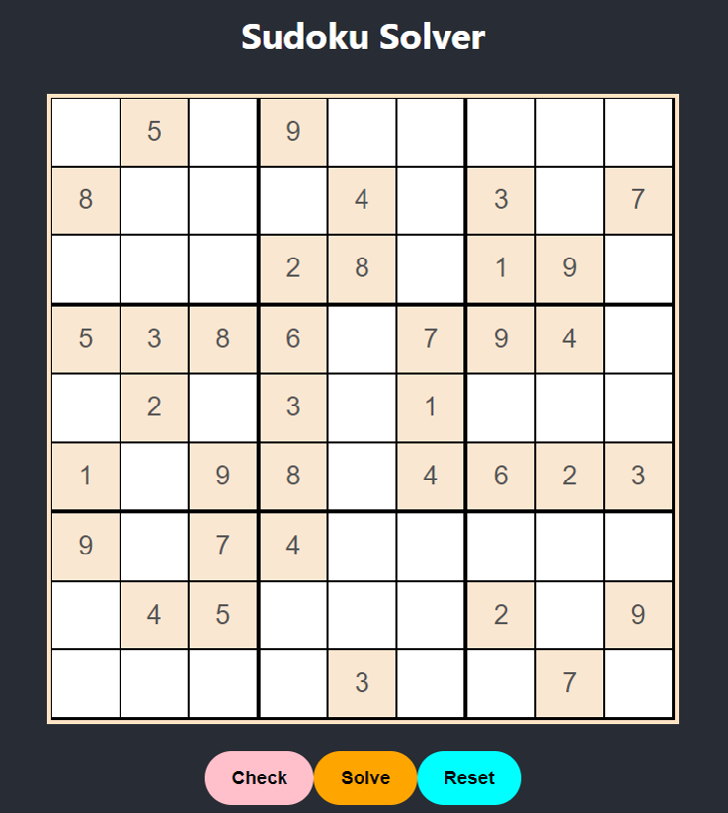
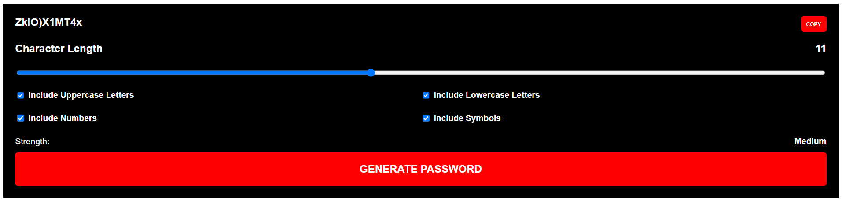
Brief About our Individual Projects

Slide 5
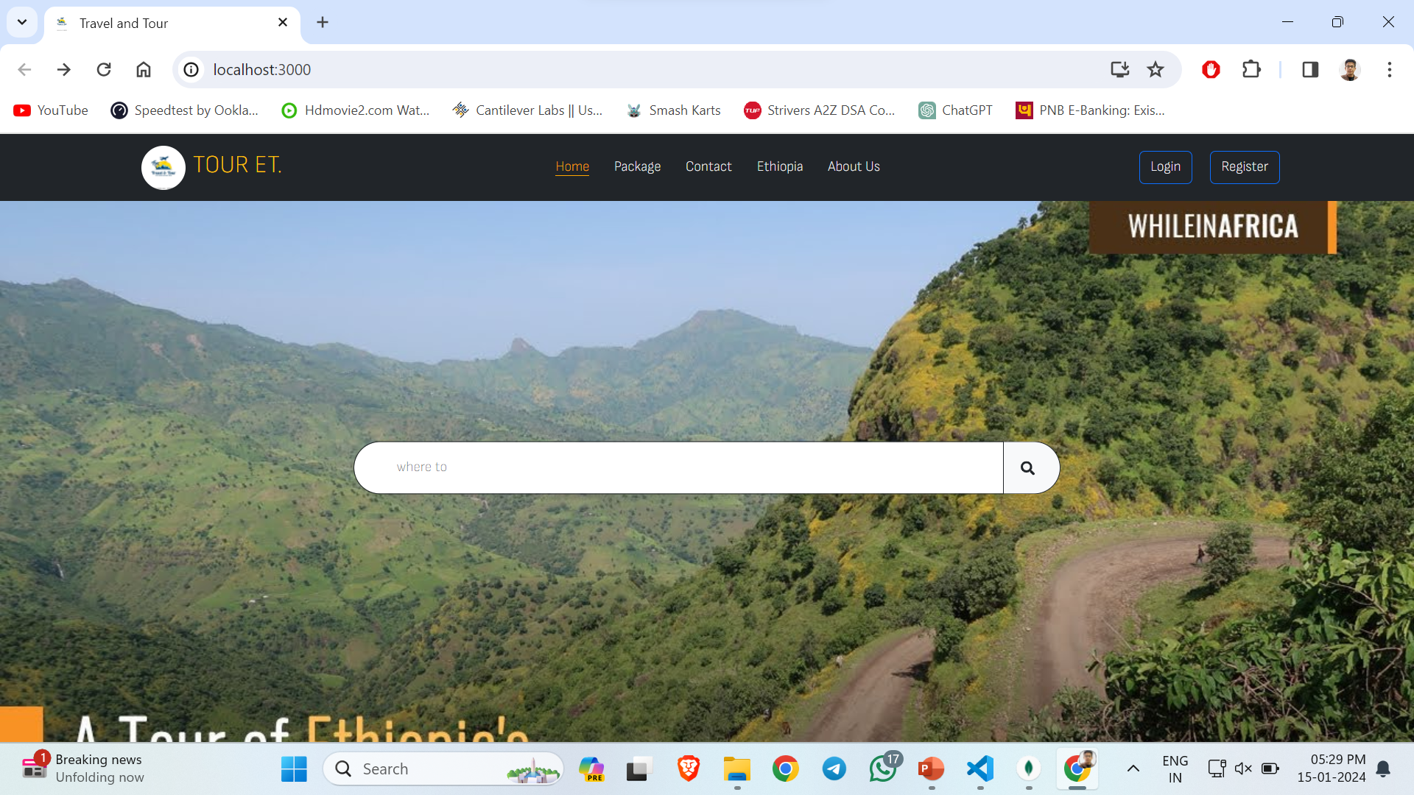
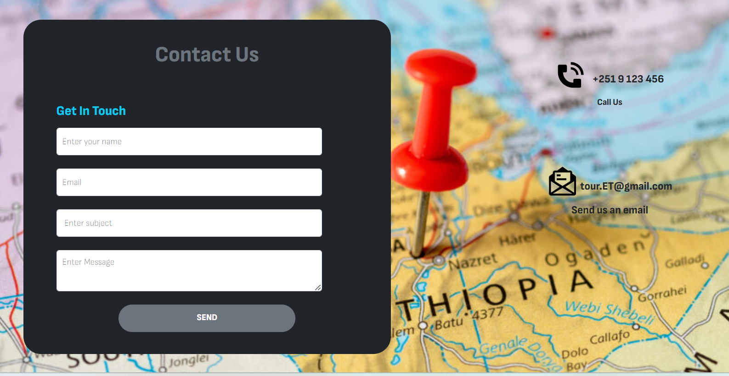
Our Main Project

Slide 6
Tourism Website
A MERN stack-based tourism website offers a dynamic and interactive platform, seamlessly combining MongoDB, Express.js, React.js, and Node.js technologies. Providing users with engaging experiences, it leverages a robust backend, responsive frontend, and real-time data to showcase destinations, facilitate bookings, and enhance the overall travel planning process.

Slide 7
Introduction
Welcome to our innovative tourism website, where exploration meets seamless planning. Built on the MERN (MongoDB, Express.js, React.js, Node.js) stack, our platform offers a captivating journey into diverse destinations. Discover immersive travel experiences, plan your dream vacations effortlessly, and embark on unforgettable adventures with our user-friendly and feature-rich tourism website.

Slide 8
Significance of mern
The MERN stack, encompassing MongoDB, Express.js, React.js, and Node.js, is highly significant in web development. It offers a unified JavaScript-based development environment, streamlining both server-side and client-side tasks. React.js enhances user interfaces with real-time updates, while Node.js ensures scalability. MongoDB's NoSQL flexibility accommodates agile development, and the stack's extensive community support contributes to its popularity in building responsive and scalable web applications.

Slide 9
Features
Diverse Travel Packages
Affordable prices
User ratings and reviews
Customer support
Search and Filters

Slide 10
Technologies Used
Reactjs: A JavaScript library for building user interfaces.
Bootstrap: For responsive design and UI components.
Google Maps API: For interactive mapping and geographical features.
MongoDB: NoSQL database for storing application data.
Express.js: Web application framework for Node.js.
Node.js: JavaScript runtime for executing server-side JavaScript.
JWT (JSON Web Tokens) for secure authentication.
bcrypt.js for password hashing and security measures.

Slide 11
Challenges faced during development process
API Scalability : Scaling the API infrastructure to accommodate increasing traffic and user interactions posed significant challenges.
Third party Integration : Coordinating and debugging integration with various third-party APIs demanded meticulous attention to ensure seamless functionality.
Performance optimization : Ensuring optimal performance and responsiveness across different devices presented complex optimization hurdles.

Slide 12
Key features of website
Map Functionality : Users can explore the map, view the locations of different places, and possibly interact with markers to get more information about each place.
Providing Review : Users may have the option to rate a place (e.g., give it a star rating) and provide written feedback. Reviews may be displayed on the website to help other users make informed decisions.
3. Add to Cart Functionality : Users can view their cart, see the items they've added, and proceed to checkout or perform other actions related to the cart.

Slide 13
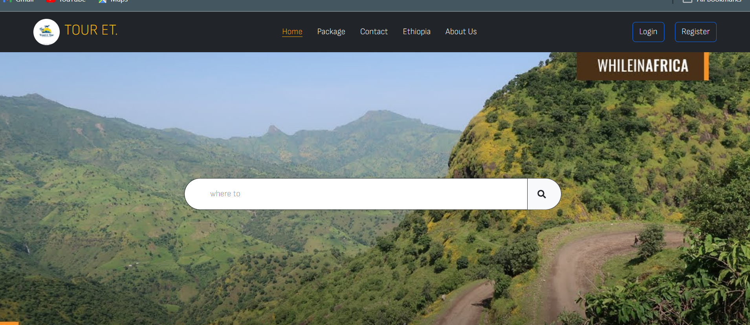
Home Page
Purpose : Serves as the initial landing page, offering an overview of the application's content.
Functionality : Provides navigation links and highlights key features to engage users.

Slide 14
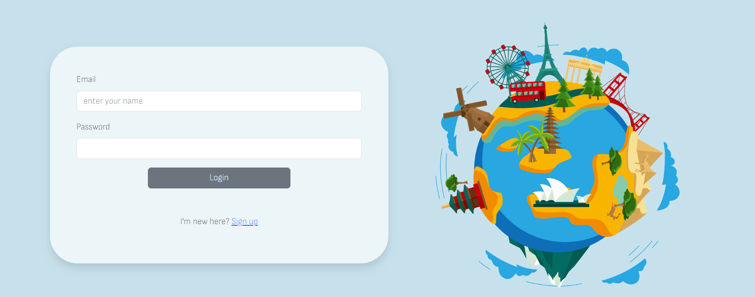
Login page
Purpose : Provides a secure entry point for users to access their accounts.
Functionality : Authenticates users based on credentials, granting access to personalized content.

Slide 15
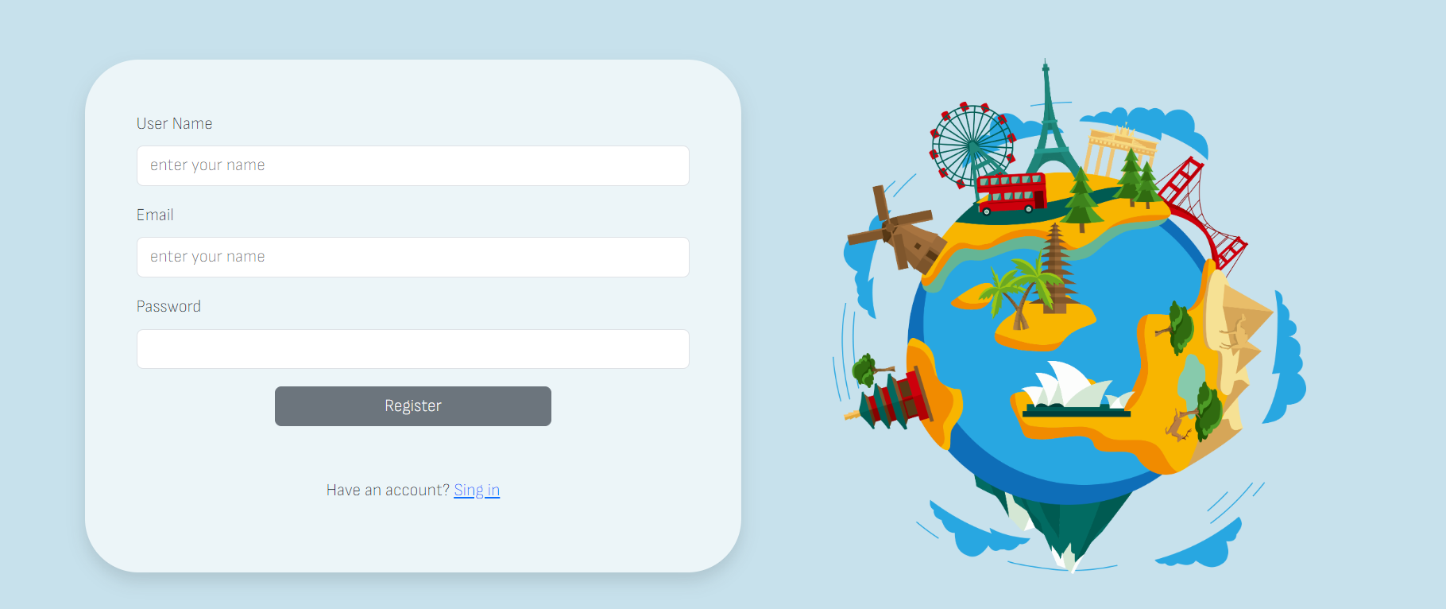
Register page
Purpose : Allows users to create new accounts by providing necessary information.
Functionality : Captures user input, validates data, and triggers account creation processes.

Slide 16
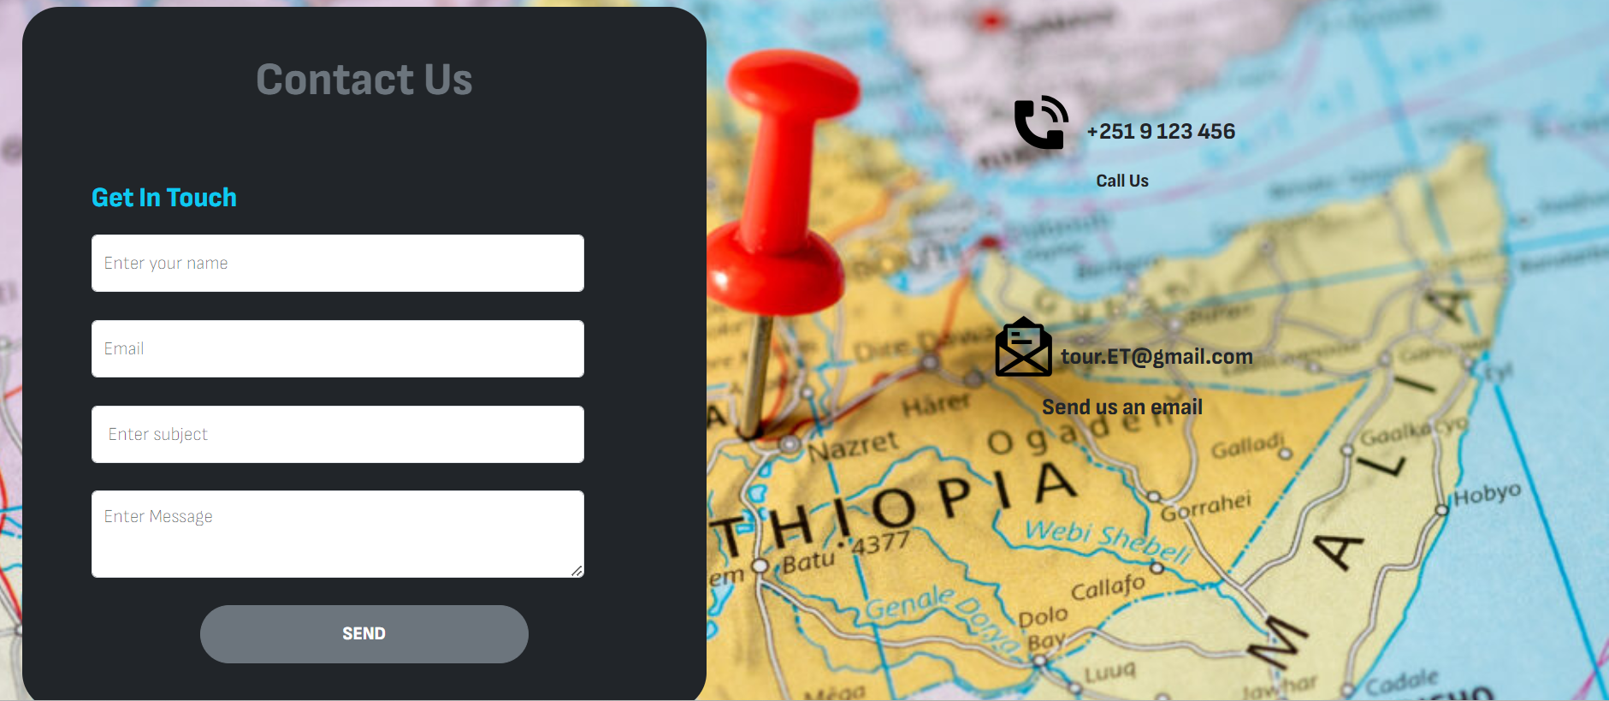
Contact Us
Purpose : Facilitates user communication with the application or website administrators.
Functionality : Collects user inquiries or feedback through forms or contact information.

Slide 17
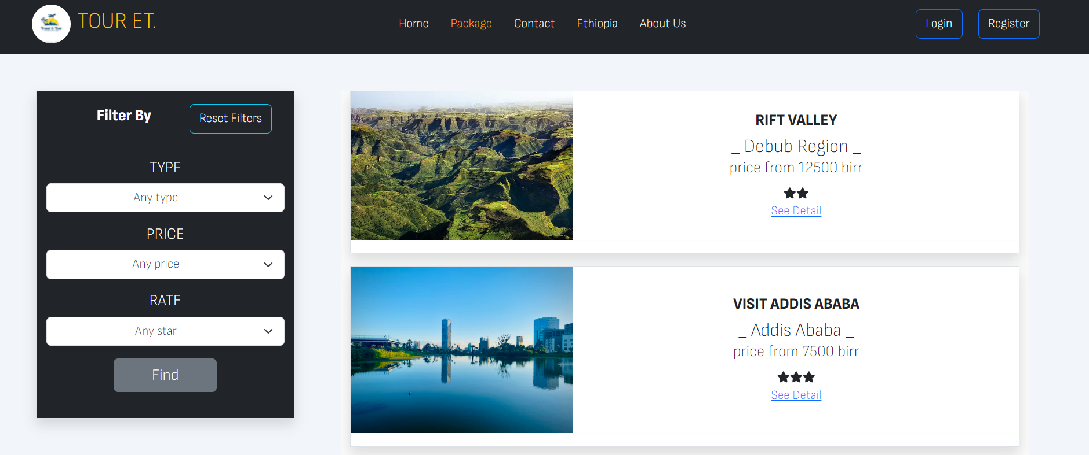
Packages we have
Purpose : Displays information about available travel packages or services.
Functionality : Showcases details such as package names, descriptions, and pricing for user consideration.

Slide 18
Backend components
Models
Controllers
Routers

Slide 19
Models
Models represent the structure and attributes of entities within a system, defining how data is organized and stored.
Some of models used in our project are:
1. Package Model : Represents travel packages, containing details like package name, description, and pricing.
2. Comment Model : Manages user comments or reviews associated with various entities, with fields for user, content, and timestamp.
3.Booking Model : Represents user bookings or reservations, storing details like user, package or room booked, and number of people.

Slide 20
Controllers
A controller in software development acts as an intermediary component that manages the flow of data and communication between the user interface and the underlying application logic or model.
Some of controllers used are :
1. User Controller : Manages user-related operations, handling authentication, user profiles, and interactions in the system.
2. Package Controller : Oversees operations related to travel packages, including creation, retrieval, and modification of package information.
3. Comment Controller : Controls user comments and reviews, facilitating actions such as adding, retrieving, and moderating comments on various entities

Slide 21
Routers
A router in web development manages navigation by determining which components to display based on the current URL. It facilitates the creation of distinct routes, allowing developers to organize and structure the content within a single-page application. Frameworks like React Router and Vue Router provide tools for implementing client-side routing in JavaScript applications. Routers play a crucial role in creating dynamic and interactive user interfaces, enabling seamless transitions between different views or pages. They are integral to the development of modern, responsive web applications.

Slide 22
Summary
The project is focused on ongoing user feedback analysis to improve the website's user experience continually. Future initiatives involve enhancing scalability and performance to accommodate growing user demands. The project emphasizes a commitment to continuous innovation, staying ahead in the travel industry by adapting to upcoming technologies.

Slide 23
THANK YOU

